Slide 1
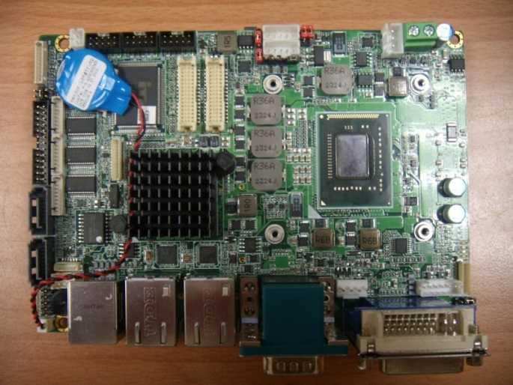
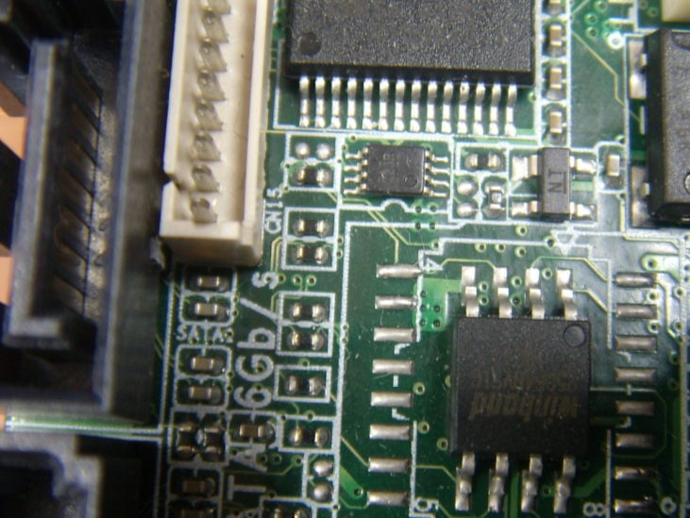
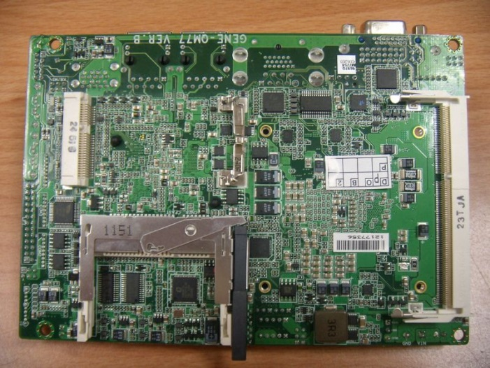
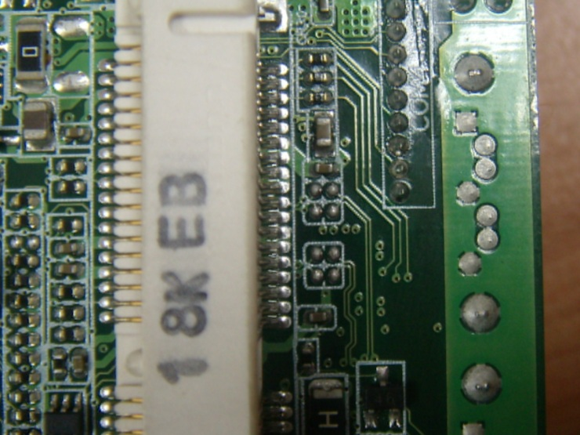
How to change Mini Card to mSATA on GENE-QM77 Rev. B
1. Remove 4 resistors as below
2. Add 4 capacitors to below location
CAP value: 0.01uF, Size 0402
3. Move the 1210 resistor right by original location.

Slide 2
BOM changes
(1) Remove R188, R195, R200, R202
(2) Add C610, C614, C628, C631 (11C2501790; 0.01uF, 25V, 0402)
(3) Move R519 to R518

