Slide 1
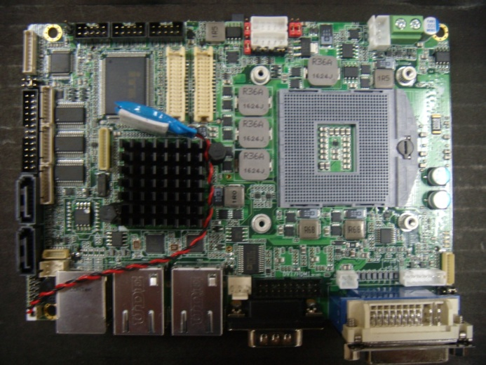
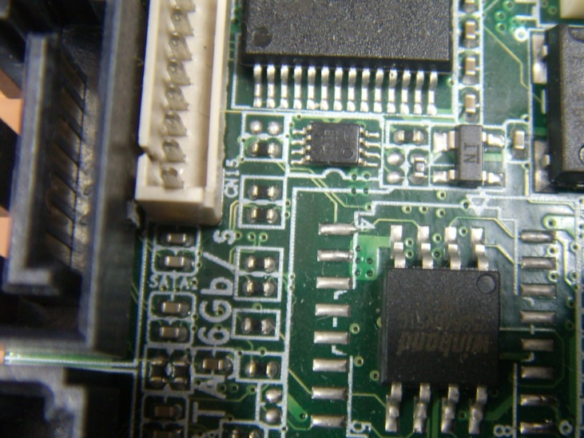
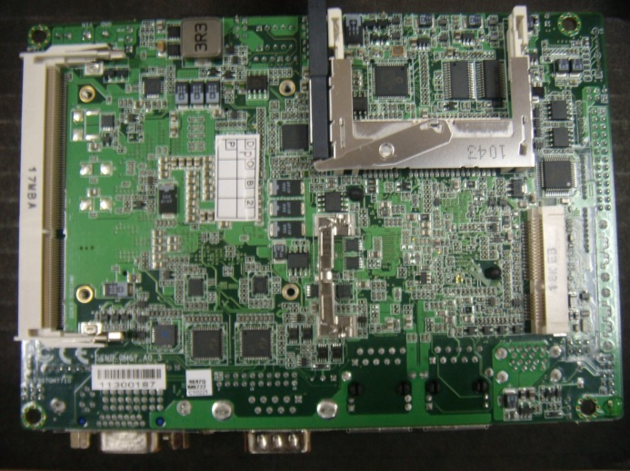
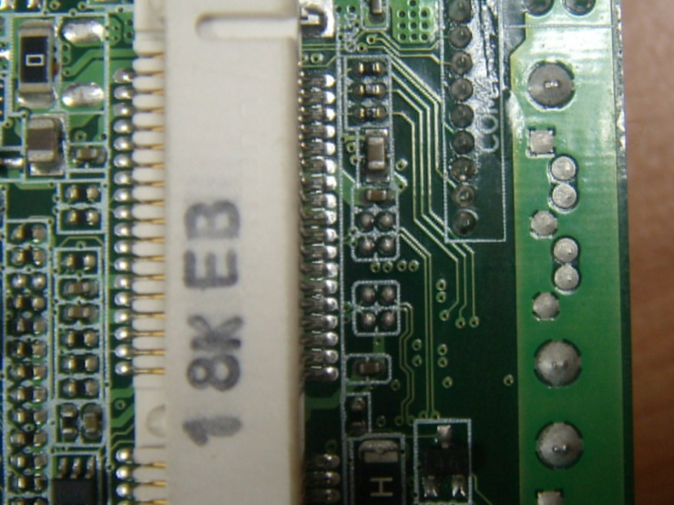
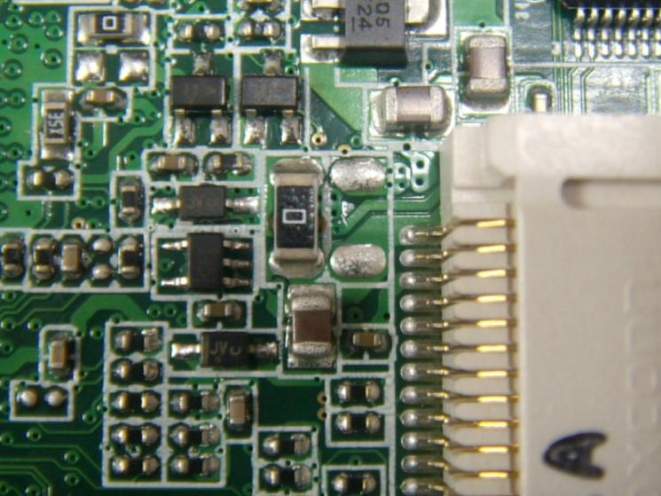
How to change Mini Card to mSATA on GENE-QM77 A
1. Remove 4 resistors as below
2. Add 4 capacitors to below location
CAP value: 0.01uF, Size 0402
3. Move the 1210 resistor right by original location.

