Slide 1
The Company
AAEON 2014
an ASUS assoc. co.
Part 3: DMS & ODM Services
April, 2014

Slide 2

Contents
Design Manufacturing Services (DMS)
Customer-Oriented ODM and Customization Services

Slide 3

AAEON
Design Manufacturing Services (DMS)

Slide 4
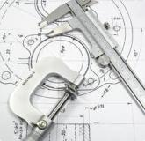
Today’s Industry Challenges
Demand for more complex products with higher quality and longer life
Increase in competition. Requires advanced technology & diverse features
Shortened delivery times & reduced inventory
TODAY’S
DYNAMIC BUSINESS
ENVIRONMENT IS
CREATING MORE
CHALLENGES THAN
EVER BEFORE
Greater flexibility in manufacturing locations
Lower production costs

Slide 5
AAEON Design/Manufacturing/Service
Assigned a Customer Focused + Service Oriented team that provides comprehensive support in Design, Manufacturing and Services, aiming to exceed customer’s expectation
A leading manufacturing service provider with best-in-class capabilities and continuous drive for flawless execution
DESIGN
MANUFACTURING
SERVICE
Product Conceptualization
Electronic Circuit Development
PCB Layout
Component Qualification
Mechanical Design
Prototype Building
Compatibility, Reliability & Qualification testing
Certification & processing (Agency Approvals)
Manufacturing Design
Packaging & Enclosure Design
PCBA Assembly
System Manufacturing
Component & Subsystem Assembly
Functional Testing
Engineering Change Management
BTO (Build to Order)
Supplier Qualification
Warehousing
Failure Analysis
Customer Service Management
Customer & Channel Repair
Logistics Extension
Refurbishment
Return Processing
Troubleshooting Support
Upgrades
Warranty Management
Spare Parts Management

Slide 6






AAEON DMS - All the Answers
Specialized
Design
Customer focused & service-oriented
Professionalism
On Time Delivery
End to End Service
Accountability
Reliability
Total Satisfaction
Competitive Cost
AAEON DMS Solution
Collaborative Development
Customer Focused Resource
Global Logistics
E2E Quality Management
Focused Account Management
Technology Leadership
Local Support
Guaranteed
Quality
Low Touch
[Chris] Not sure what “Low Touch” refers to
Faster Time to Market

Slide 7

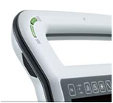


Aligning with AAEON DMS
Latest technology and solutions help provide customers with the most advanced platforms, helping customers stay ahead of competition
Offer customers the highest quality products and services at unprecedented levels of efficiency and professionalism
AAEON DMS offers a complete Service Package tailored to fit each customer’s needs:
Project Management
Product Design
End-to-End Quality Management
Global Services and Programs
Global Logistics
Quality Manufacturing
Product Conceptualization
Product Development
Quality Manufacturing
Service Programs

Slide 8









AAEON DMS - Platform Overview
Provides end-to-end service for optimal customer satisfaction through dedicated and professional design expertise
AAEON DMS Division - Functional Breakdown
Account Management
Product and Project Management
System Engineering
Mechanical Engineering
Account Quality Management
Hardware
(EE)
AAEON Resources
AAEON Focus Domain
ASUS Support Resource
Fulfillment
Front-end Support
Manufacturing
Regional Sales Force
RMA Service
Sourcing/ Procurement
Design Support Center (Software, Layout,
BIOS, etc.)
Quality Assurance

Slide 9
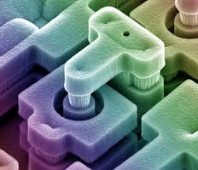
on design
The Design Engineering team is the driving force behind every product created for AAEON’s customers, offering a comprehensive array of professional value-added design and engineering services customer’s deserve.
Project discussion begins with understanding every aspect of the desired product, addressing all related engineering challenges such as material consideration, component selection, functionality, testing challenges, manufacturing, stress, packaging and environmental impact. From this understanding, AAEON is capable of satisfying all customer product development requirements.
Design
Competence
Industrial Design
System Integration
BIOS and Firmware Technology
Power Management Technology
Space Saving Technology
Ruggedized Technology
Wireless Integration

Slide 10

on manufacturing
AAEON offers industry leading manufacturing services from PCBA assembly, sub-system assembly, system integration (including LVHM product assembly), to all related in-process quality assurance testing. AAEON’s expertise guarantees seamless integration of each product development stage during the manufacturing process.
Supply Chain Management
Assembly Services
Quality Control
A highly integrated project management process flow and close management and knowledge of component suppliers helps to ensure optimum utilization and efficiency of the supply chain. AAEON customers can always be confident and assured that from product development through volume manufacturing , their products and services will be professionally managed.
AAEON offers complete sets of board level and system level assembly services to maintain pace with the increasing needs of our customers. Customers can utilize AAEON’s manufacturing services for various products using different manufacturing models. AAEON provides standard system assembly as well as Low Volume High Mix and Build-to-Order models.
With closed loop quality assurance at the manufacturing level, AAEON ensures the execution of the production plan stays on schedule while meeting the quality expectations of our customers. It starts with close examination of incoming materials through the final assembled and packaged sample for testing. In between, a full suite of standard industry tests are implemented to make certain AAEON can match or exceed the customers’ rigorous requirements.

Slide 11

on services
AAEON provides a comprehensive array of flexible and innovative service solutions through experienced professionals to support all of AAEON’s product offerings.
A dedicated AAEON team plays a key role in initial discussions with the customer’s product development team to strategically plan for the expected lifecycle of the product.
Products have different service requirements, which may vary by geography. An AAEON Service team would work closely with customers to develop the optimal after-sales service program for each product.
Regional RMA Centers for Quick Turn-Around Time
Customer Point of Contact provided for:
  Corrective Actions
  Complaint Management
Spare Parts Supply
EOL Services
Measurement of Field Return Rate per product / customer

Slide 12

AAEON DMS Benefits
Project Management offers all required services and a local single-point-of-contact
Regional support with Build-to-Order (BTO) production with logistical sites in USA & Europe
On Time-to-Market
Long Life Cycle Management
Guaranteed quality performance by Corporate standards
Secured business continuity by flexible production mix; incorporating in-house & contracted manufacturing
Cost savings throughout the value chain:
  Reduced R&D costs by outsourcing to AAEON Engineering team
  Low material costs with centralized purchasing, leveraging ASUS buying power
  Cost efficient production
IP Protection
Reduced Inventory reduces working capital
Reduced Investments in R&D and Production Assets

Slide 13

Synergy with ASUS
Longevity
Revision Control
High Mix Mfg. Volume
Domain Knowledge
Ruggedized Design
AAEON
Better Price
Reliable Relationship
Leading Technology
Global Support
Solid Quality Control
Leverage
ASUS Resource
Competitive Cost
Strong Finance Support
Technology Leadership*
Global Mfg, Logistics, Service
Supply Chain Management
Solid Quality Control
Values for IPC Customers
*ASUS maintains a very solid R&D Team & facility in-house

Slide 14
AAEON DMS Development Process
P1
Planning Stage
C1
P2 Design Stage
C2
P3 Verification Stage
C3
P4
Pre-Production Stage
C4
P5
Pilot Run Stage
C5
NPD Decision
Project team formation
Design completed
Sample build
Sample evaluation
Design verification
Manufacturability
Production evaluation
Pilot Run review
Mass Production
Product Mgmt
R&D
DQA
Product Mgmt
R&D
Engineering
DQA
Procurement
Customer Service
Product Mgmt
R&D
Engineering
DQA
Customer Service
Product Mgmt
R&D
Engineering
DQA
QC
Manufacturing
Procurement
Customer Service
Product Mgmt
R&D
Engineering
QC
Manufacturing
Procurement
Customer Service
Product Mgmt
R&D
Product Mgmt
R&D
Engineering
Procurement
Product Mgmt
R&D
Engineering
DQA
Product Mgmt
R&D
Engineering
QC
Product Mgmt
R&D
Engineering
Customer
Service

Slide 15
AAEON DMS Development Process
Contract Manufacturing (CM)
Commercial off-the-shelf (COTS)
Customized COTS
Joint Development
(JDM)
Original Design Manufacturing (ODM)
Customer-owned design
AAEON provides manufacturing and engineering service
Based on AAEON standard product & technology roadmap
With optional minor changes
Based on AAEON standard product & technology roadmap
Modify according to customer’s request
Strategic Partnership
Co-architected design based on common IP from technology roadmap
Customer driven design
Based on customer driven product and technology roadmap
Customer
Design Qualification
AAEON
Manufacturing Design & Mftg

Slide 16


Quality Certification
ISO 9001: QMS Standards, 2008
ISO 13485: QMS Standards, 2003
ISO 14001: EMS Standards, 2004
ESD: ANSI/ESD S20.20, 2007
3C: China Compulsory Certification
CE/FCC: All AAEON products undergo and meet CE
and FCC test standards
AAEON Quality Assurance Closed Loop Feedback System
Design Quality Assurance (DQA)
Manufacturing Quality Assurance (MQA)
Service Quality Assurance
(SQA)

Slide 17




Why AAEON?
ASUS + AAEON Value-adds
A financially sound company;
a solid partnership
One-stop shop across industry sectors
Supply-chain management and buying power
Distinguished quality

Slide 18

AAEON Customer-Oriented ODM & Customization Services

Slide 19

ODM and Customization
AAEON offers HUNDREDS of Commercial-off-the Shelf (COTS) embedded board and system products.
Due to the nature of the IPC industry, all of our COTS products can be modified to suit specific customer needs.
New products with unique specifications are often created at the request of our customers.

Slide 20
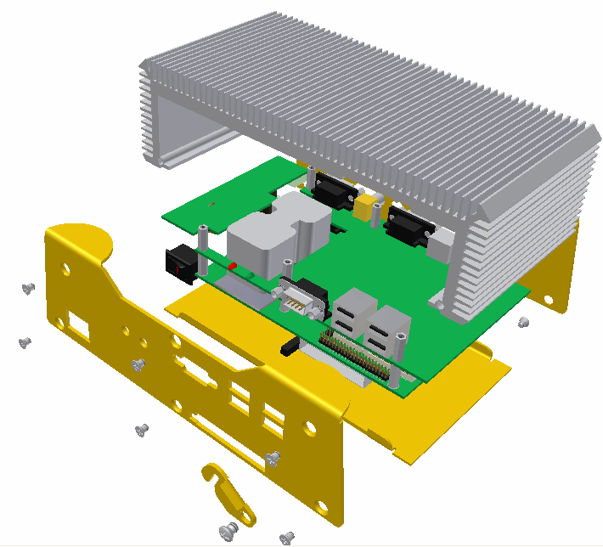
ODM Project – Enclosure Example
Variable length heat sink design
Front panel can be customized

Slide 21
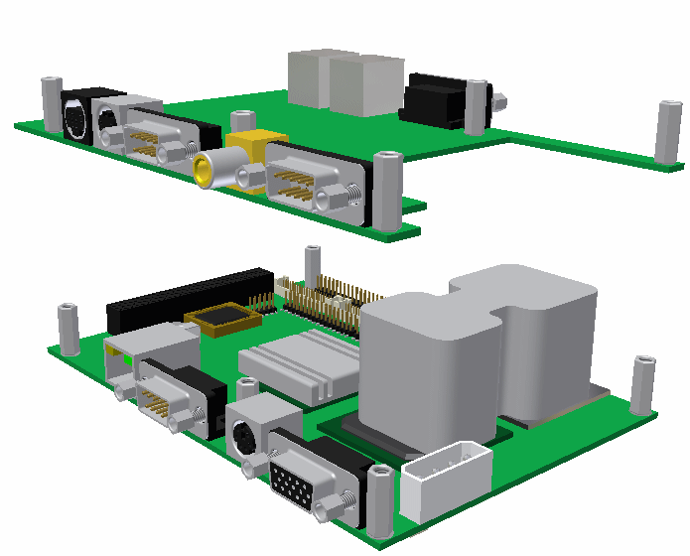
ODM Project – Board Modification
Customizable I/O board expands the configuration possibilities

Slide 22
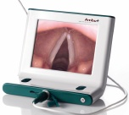
ODM Process
Customer
OH/AAEON
RFQ
HW platform proposal
Spec from the customer has about 60% readiness before discussions with AAEON
Onyx/AAEON designed all the schematic, layout, appearance design & mechanical drawing and driver for the AP, UI for the customer
ID proposal
SW&UI proposal
Choose HW platform
OH/AAEON ODM Support
Qualification proposal
Agree on proposal
Draft BOM , NRE, Price
Agree on the commercial terms & the final spec
Start development
Notes:
the process how we worked with Ambu to get the project first:
Ambu draft the RFQ (draft ID concept, Electronic features, SW & UI requirement and all certification data, actually the spec is 60% ready before).
We provide our electronic platform comparison table, ID/mechanical design and SW capability proposal.
Once they select the electronic platform, then we can roll out the BOM estimation then provide pricing and NRE.
After got their approval.
We start the design and fine tune every spec detail according to their requirement.
Q. The design is completely by Ambu and AAEON only do the production?
or we have helped Ambu in changing some component and circuitry?
A. We design all the schematic, layout, ID & mechanical drawing and driver, AP, UI.
All the design efforts were from PAA team before, they don’t even know the electronic parts. Ambu was more focus on mechanical design company.
9 months => finished
10sec boot up time
battery 2 hours => 3AA size
All ports with isolation
Patient contact

Slide 23
Ready-to-Design Block
 | x86 | ARM
Schematic design and test
Low Power feature
Wireless (GSM, RFID, WiFi, BT…)
Isolation
Battery
Seamless (easy cleaning)
ID design (Slim line and Compact)
Waterproof
Light weight
Mounting and Stand
Tooling
Driver
AP & Simple UI
Debug consult
CE / FCC, EN/UL60601
FDA 510K
Documentations

Slide 24
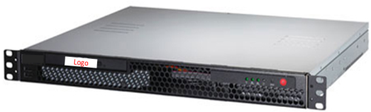
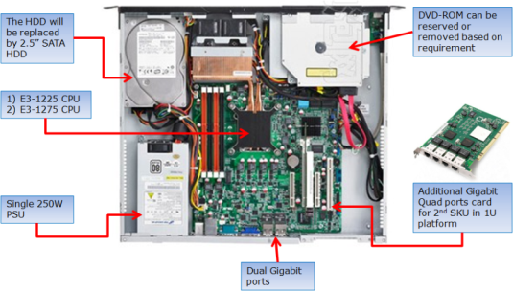
1U Network Appliance
1
A typical case with minor modification and more Ethernet ports
2
Short and compact 1U chassis required.
3
AAEON Motherboard

Slide 25
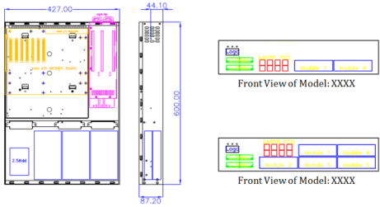
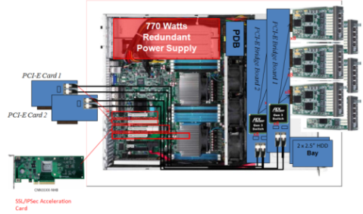
2U Network Appliance
1
Customized 2U chassis with 6 networking modules
2
Powerful motherboard with specially designed backplanes for network module swapping
3
AAEON Motherboard

Slide 26
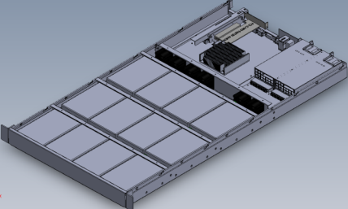
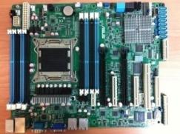
1U Storage Appliance
1
This 1U storage appliance is designed for cloud computing storage
2
Combination of 1U with 12 hard disks and dual PCI-E slots fulfill high density storage with upgradable Ethernet connectivity.
3
AAEON Motherboard

Slide 27
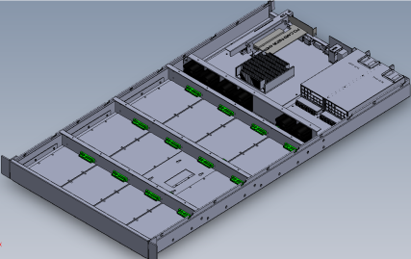
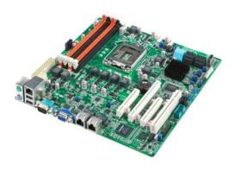
1U Data Backup Appliance
1
This 1U storage appliance is designed for data backup purposes
2
Cost effective motherboard, high density with 12 hard disks and swappable hard disks
3
AAEON Motherboard

Slide 28
Why AAEON?
 | AAEON | EMS | Server & Motherboard Manufacturers
Technology | ASUS group is a strong technology group to backup customer Expertise in Cloud Computing | Distributed technology team for different OEM/ODM accounts. It is sensitive to inter-change technology among each team | Both Intel & AMD provide early stage samples for research No expertise in cloud platform ready technology
Cost | Aggressive cost structure from leveraging ASUS procurement | Key components are consigned by its customers | Various boards are available in product portfolio
Minimum Production Policy | Flexible | Low flexibility with high volume commitment | Depends on the manufacturers
Product Availability | Selected models with high product availability | Rolling forecast is required from OEM/ODM accounts | Various models with near- zero product availability
Logistics | Over 10 branch offices in Asia, America and Europe | Depends on the manufacturers | Depends on the manufacturers

Slide 29

Any questions or for more information, please contact:
sales@aaeon.com.tw
www.aaeon.com
AAEON Technology Inc.

