Slide 1
The Company
AAEON 2014
a member of the ASUS Group
Part 2
March, 2014

Slide 2

Part 2
Vertical Applications and Solutions

Slide 3
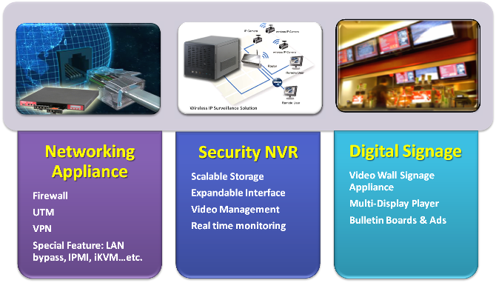
ISD Vertical Solutions

Slide 4



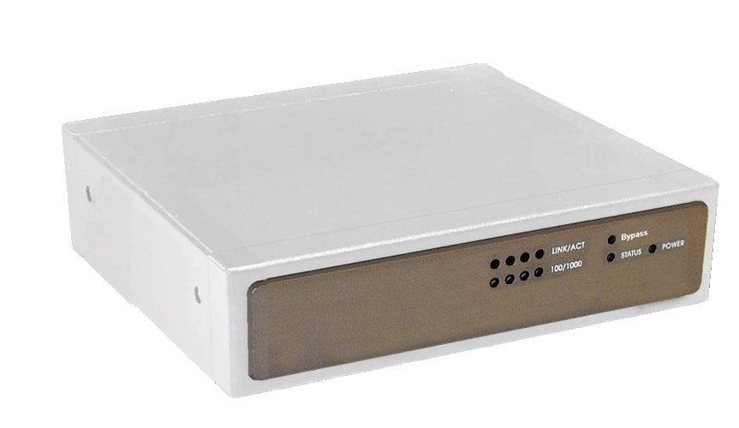



Product Roadmap
Desktop Network Appliance
Model Types
Best Selling
FWS-2200
1. Intel Atom D525 + ICH8M
2. 6 LAN (2 pairs bypass)
3. 60W Power Adapter
Q1‘14
Q2 ‘14
Intel Platform
FWS-2250
FWS-2350
1. Atom E3810, 1.46G
2. 4 LAN (1 pairs bypass)
3. USB2.0 X 2, USB3.0 X 1
4. CF card Slot x 1
1. Rangeley 2~4C
2. 4~6 LAN Port
3. Mini PCIe x 2
4. QAT Function
Intel Bay Trail
Intel Rangeley
New
Q4 ‘14
FWS-2160
FWS-2400
1. AMD T24L + A50M
2. 6 LAN (2 pairs bypass)
3. 60W Power Adapter
4. mini-PCIe Socket x 2
OCTEON III CN70, 1.6GHz
Crypto/Decrypto Function
6 LAN Port
Risc CPU
None Intel Platform
Cavium Platform
Mass Production
Developing
Planning
Time

Slide 5




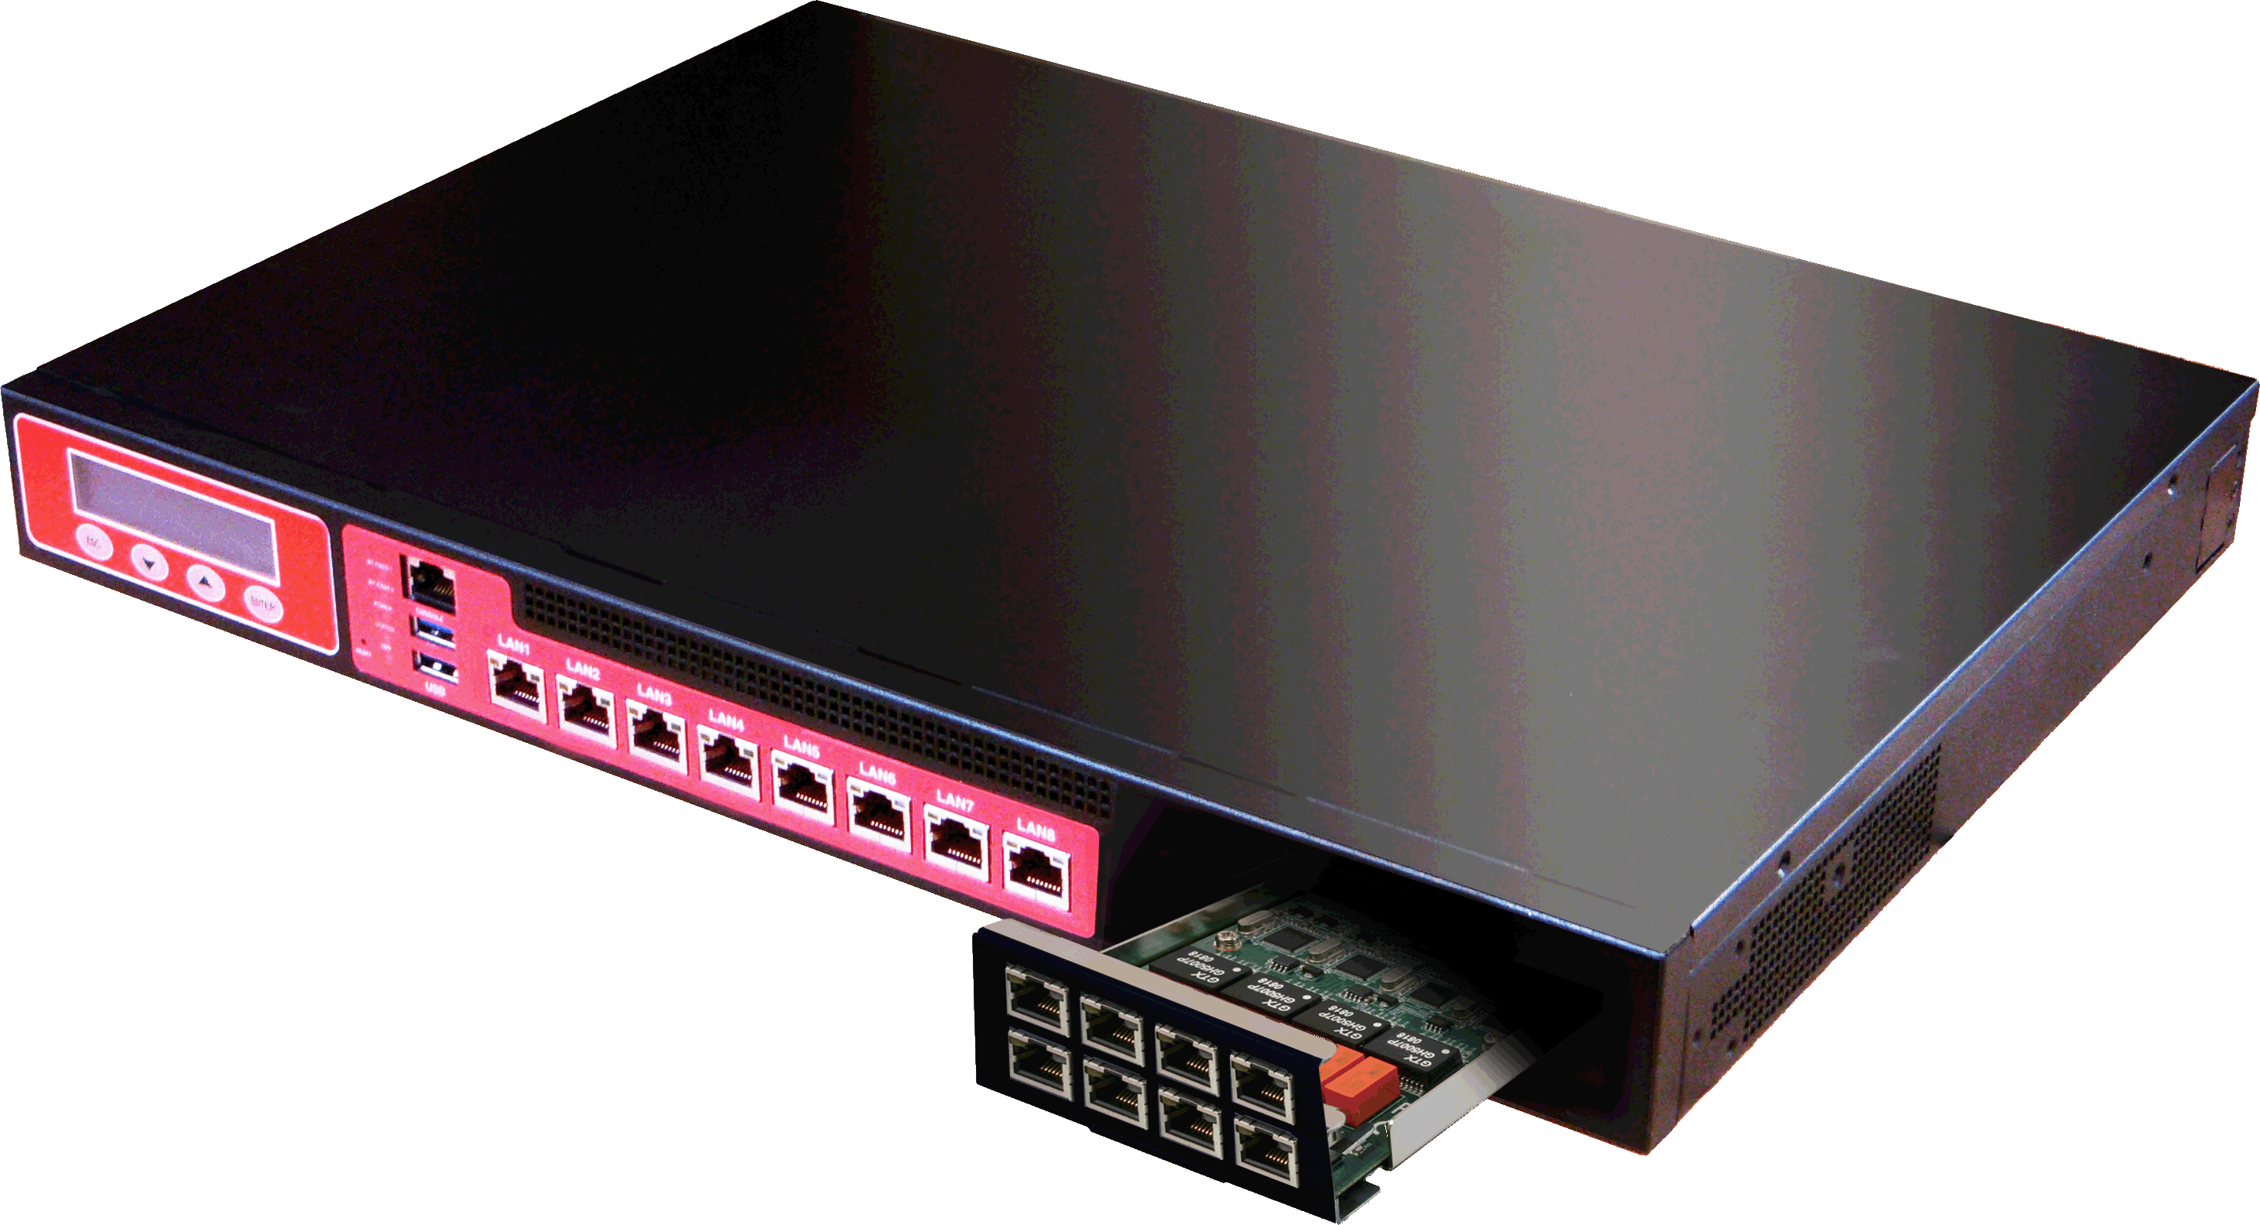



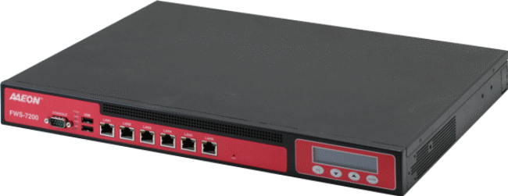
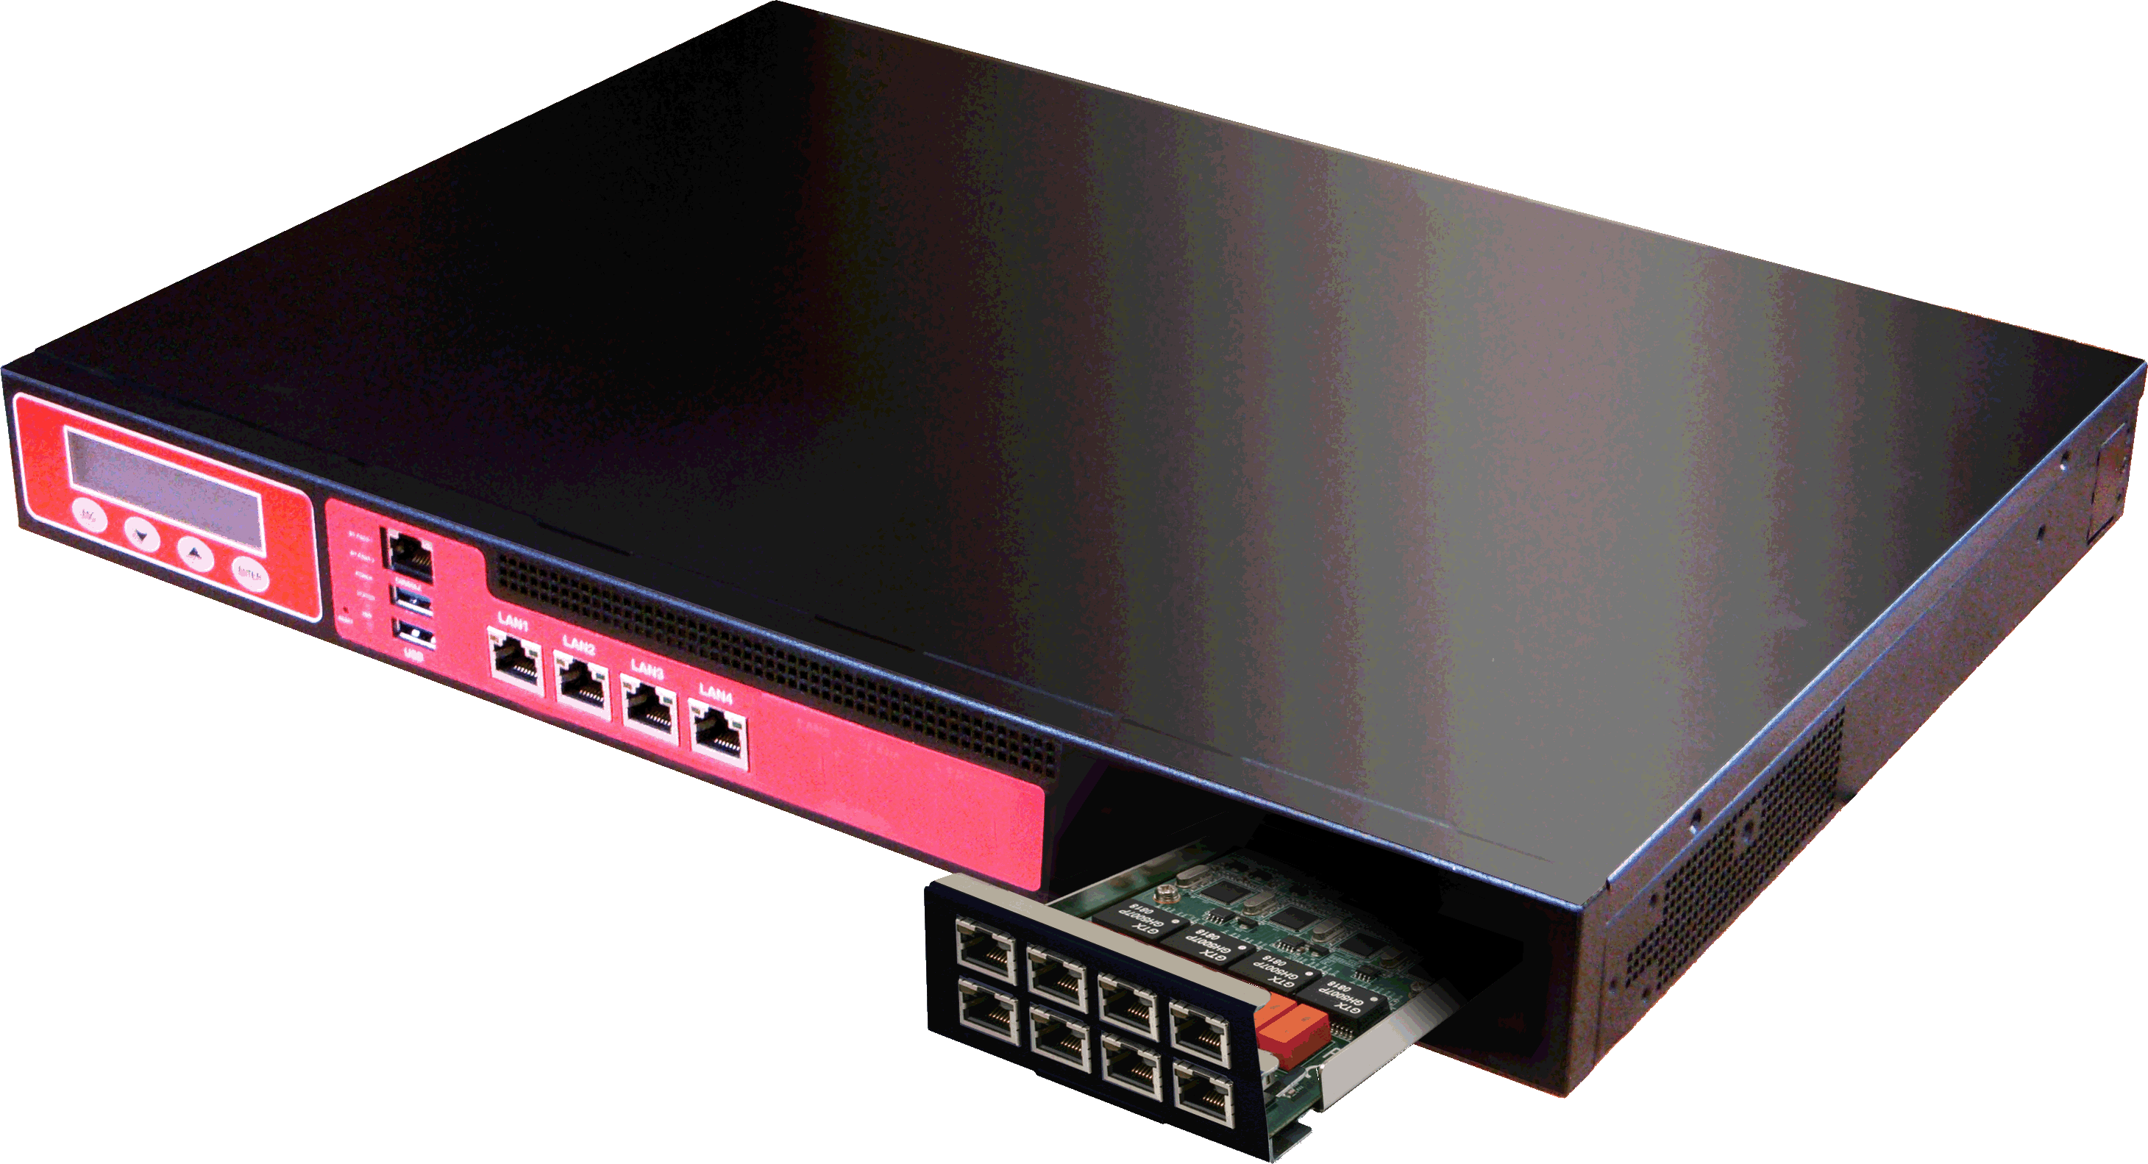
Product Roadmap
Rackmount Network Appliance
Model Types
Q3‘14
Q4‘14
FWS-8500
FWS-7500
Intel RiverForest
Intel Haswell-EP Dual CPU
Supporting up to 64GbE
QAT Supported
650W Redundant Power
Intel RiverForest
Intel Haswell-EP Dual CPU
Supporting up to 24GbE
QAT Supported
High Performance
FWS-7810
New
FWS-7400
New
FWS-7811
Q1‘14
Intel C226 Chipset
Intel 4th Core I, Xeon Processor
3. 8GbE Ports + 1 NIM Slot
4. Optional 2 pair bypass
5. 250W ATX PSU
Intel H81 Chipset
Intel 4th Core I Processor
3. 6GbE Ports + 1 NIM Slot
4. Optional 2 pair bypass
5. 250W ATX PSU
Intel C226 Chipset
Intel 4th Core I, Xeon Processor
3. 8GbE Ports + 1 NIM Slot
4. Optional 2 pair bypass
5. 275W Redundant Power
Main Stream
FWS-7350
Q1‘14
FWS-7200
1. Intel Atom D525 + ICH8M
2. 6 GbE Ports
3. Optional 2 pair bypass
4. 180W ATX PSU
Intel Rangeley Platform
Intel 4th or 8th Core SoC
3. 4GbE Ports + 1 NIM Slot
4. Optional 2 pair bypass
5. 100W ATX PSU
Value
Mass Production
Developing
Planning
Time

Slide 6
Product Roadmap
Network Interface Module (NIM)
Model Types
Q4 ‘14
Q4 ‘14
NIM-F17A
NIM-F19A
1. PCI-E Host Interfaces x 8
2. 10 GbE SFP Fiber LAN x 2~4
1. PCI-E Host Interfaces x 8
2. 40 GbE SFP Fiber LAN x 2
>10GbE SFP+
For FWS-8500/7500
For FWS-8500/7500
Q2 ‘14
Q3 ‘14
NIM-C15A
NIM-F11A
1GbE SFP+
1. Dual PCI-E Host Interfaces x 4
2. 1 GbE SFP Fiber LAN x 8
1. Dual PCI-E Host Interfaces x 4
2. 1 GbE SFP Fiber LAN x 4 (max. 2 paris bypass
For FWS-8500/7500
For FWS-8500/7500
Q2 ‘14
NIM-C13A
1GbE
Copper
1. PCI-E Host Interfaces x 4
2. Copper GbE x 8
3. Up to 2pairs of Bypass Function
For FWS-8500/7500
Mass Production
Developing
Planning
Time

Slide 7


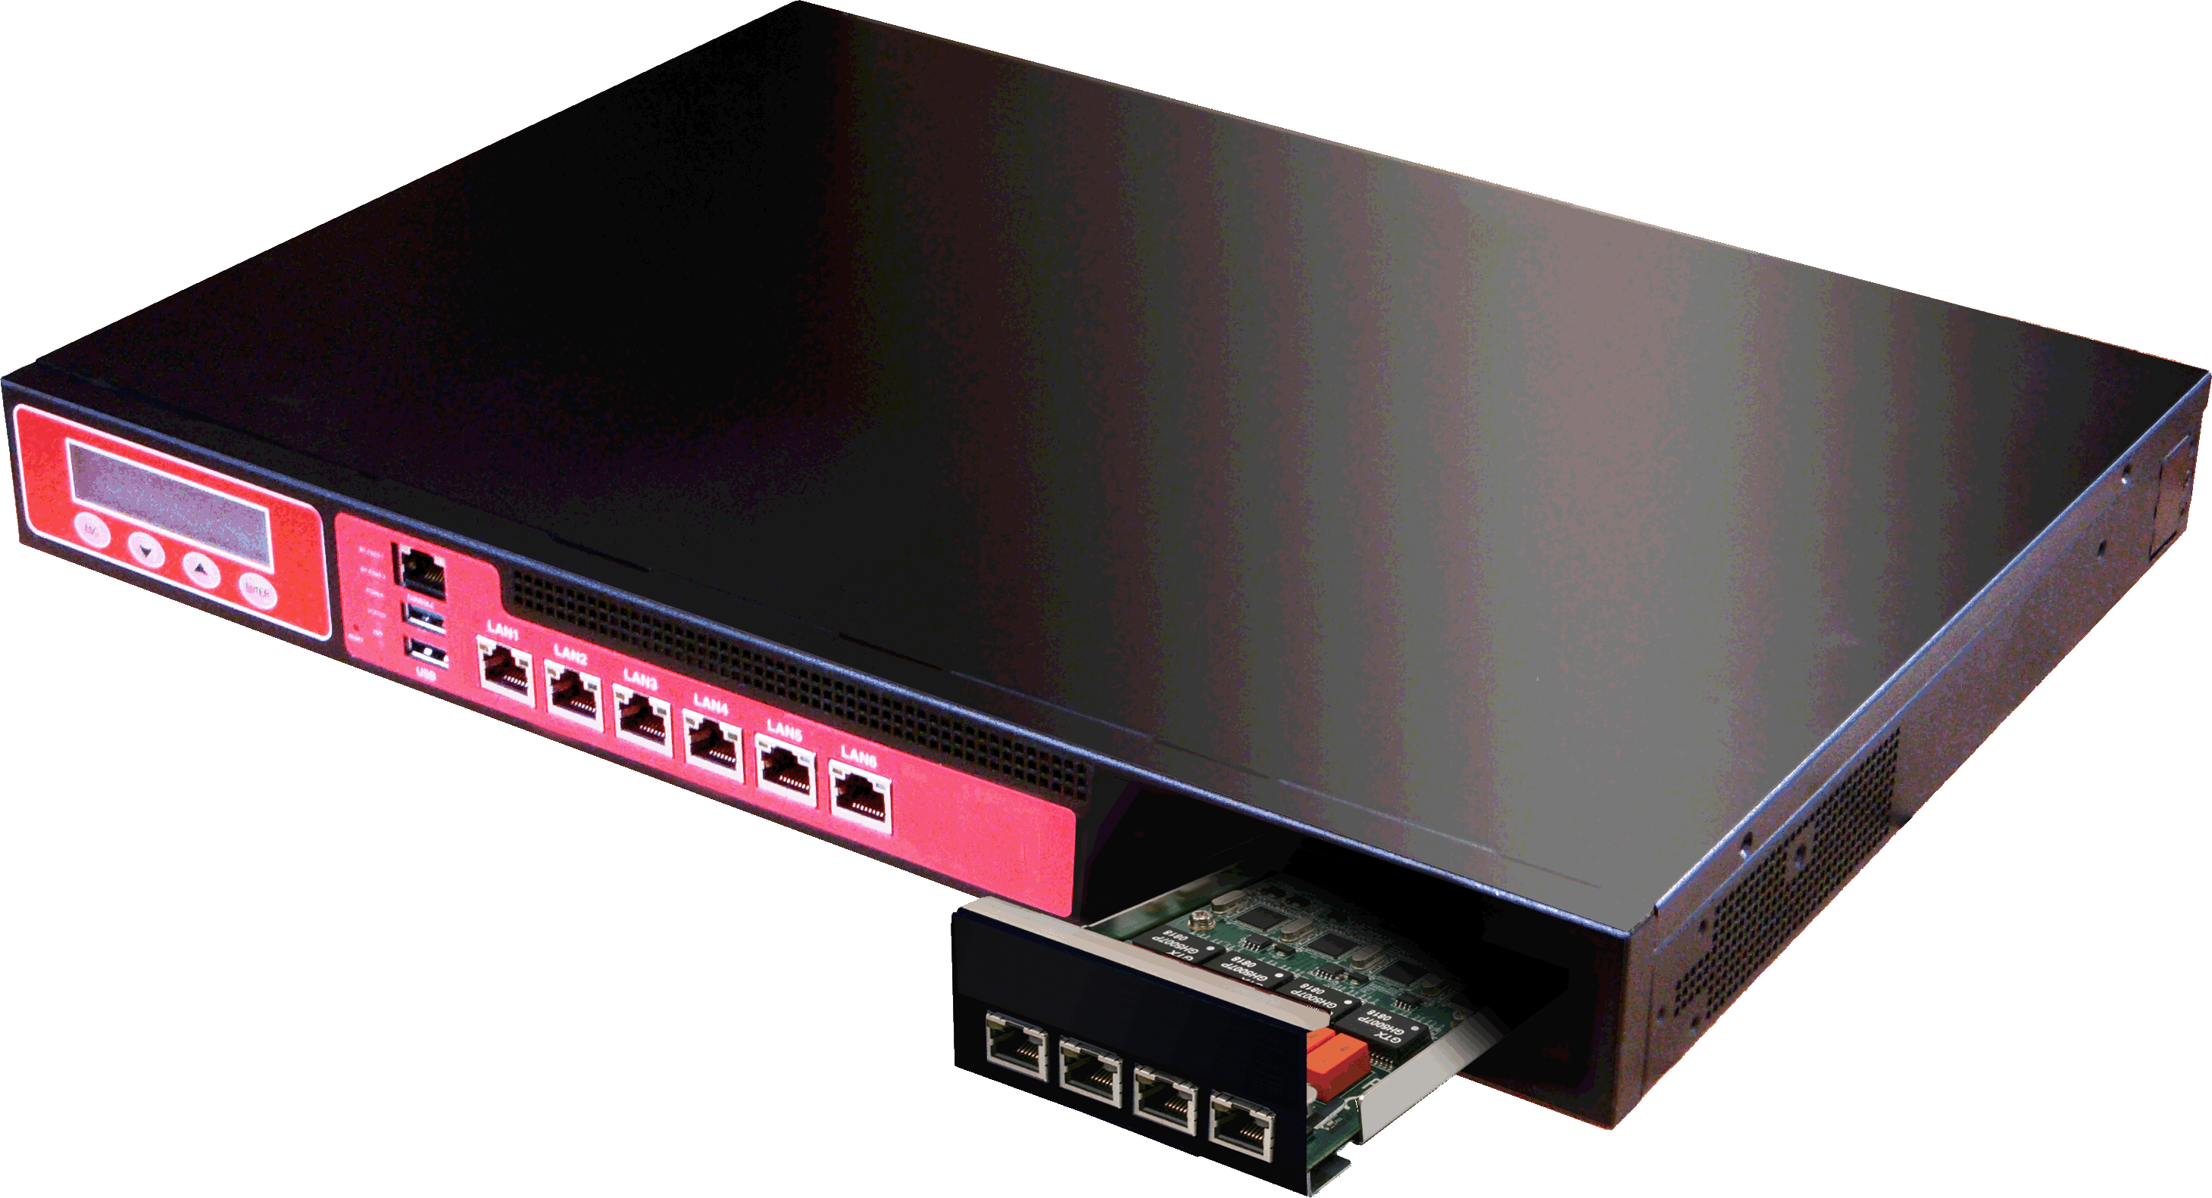
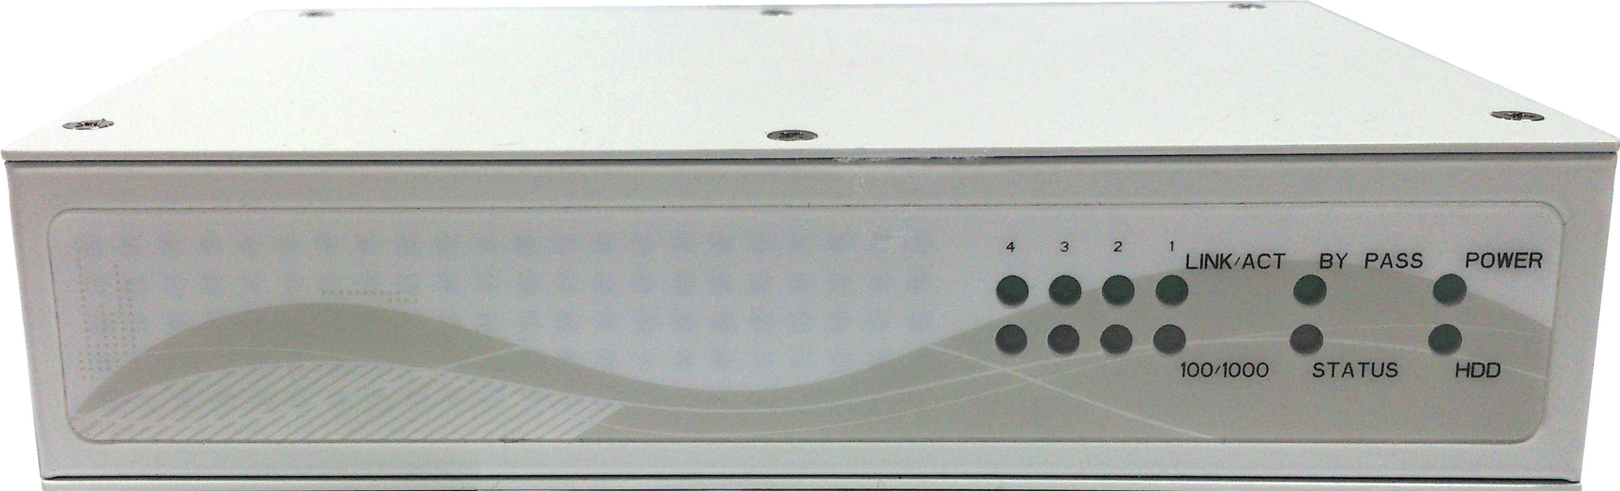
2013
2014
Product Brief
Intel Roadmap for Network Appliance
Crystal Forest Server
Highland Forest
River Forest
Comms
Performance
Sandy Bridge EP/EN (LGA)
Ivy Bridge EP/EN (LGA)
Haswell EP/EN (LGA)
Cave Creek
Coleto Creek
FWS-8500
I/O Intensive
Haswell Workstation Platform
4th gen Intel® Xeon and Dual Core Processors (LGA)
C226 Chipset
FWS-8500
Value
Haswell Value Platform
4th gen Intel® Pentium® and Celeron Processors
H81 Chipset
FWS-7810
Crystal Forest Gladden
Rangeley {Silvermont Core} SOC (BGA)
Comms
Entry
Gladden {SNB} 1C (BGA)
Cave Creek
FWS-7350
Value SoC
Bay Trail Platform
Intel® Celeron™ Processor J1920
FWS-2250

Slide 8

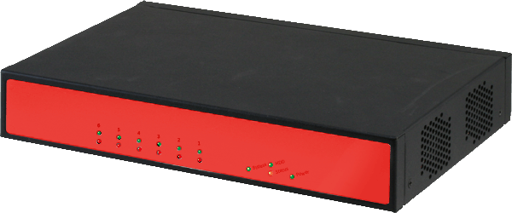
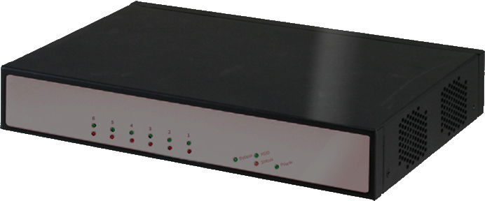
Product Brief
AAEON Desktop Network Appliance Strategy
Model Name | FWS-2200 | FWS-2250 (2C SKU) | FWS-2350 (2C SKU) | FWS-2160
Platform | Intel PineView | Intel BayTrail | Intel Rangeley | AMD G-Series
Processor | Intel® Atom D525 Dual Core 1.8GHz | Intel® Atom E3815 Single Core 1.46GHz | Intel® Atom C2358 Dual Core 1.7GHz | Onboard AMD G-series T24L 1.0 GHz
Chipset | ICH8M (kit price :$30) | Intel® BayTrail SoC ($20) | Intel® Rangeley SoC ($43) | AMD A50M (kit price $23)
Memory | 2 x 240 DIMM, DDR3 800 up to 4GB | 2 x 240P DIMM, DDR3 1600 up to 16GB | 2 x 240P DIMM, DDR3 1600 up to 16GB | 2 x 240P DIMM, DDR3 1600 up to 8GB
LAN Ports | 6 ports (INTEL 82574L) | 4 ports (INTEL I211) | 6 ports (INTEL I210) | 6 ports (RealTek RTL8111E)
Bypass | Max. 2 Pair (Optional) | Max. 1 pair (Optional) | Max. 3 pair (Optional) | Max. 2 Pair (Optional)
Cooling | 2 x System Fan | Fanless | 1 x System Fan | 1 x System Fan
Dimension (Estimated) | 260mm(W) x 178mm(D) x 44m(H) | 165mm (W) x 105mm(D) x43mm(H) | 260mm(W) x 178mm(D) x 44m(H) | 260mm(W) x 178mm(D) x 44m(H)
Power | 60W/12VDC-IN Power Adapter | 40W/12VDC-IN Power Adapter | 60W/12VDC-IN Power Adapter | 60W/12VDC-IN Power Adapter
Other Features | NA | NA | QAT | NA
Price Strategy | Best selling | Lowest INTEL Solution | Intel Solution with QAT Function | Lowest Desktop Solution

Slide 9
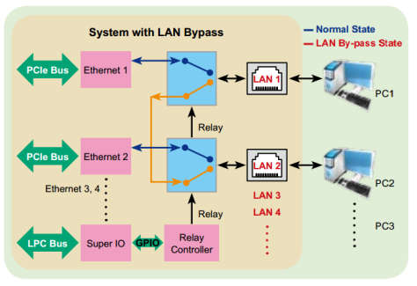
Network Appliance HW Features (1)
Bypass Function
LAN Bypass feature removes a single point of failure so that essential business communication can continue while a network failure is diagnosed and resolved. In the event of a power, hardware or software failure, Hardware Bypass will automatically activate, allowing network traffic to continue. Traffic between the LAN and WAN will continue without interruption.
AAEON Bypass Function
Power failure mode
System failure mode
Force bypass mode (Programmable)
Jumper-less

Slide 10
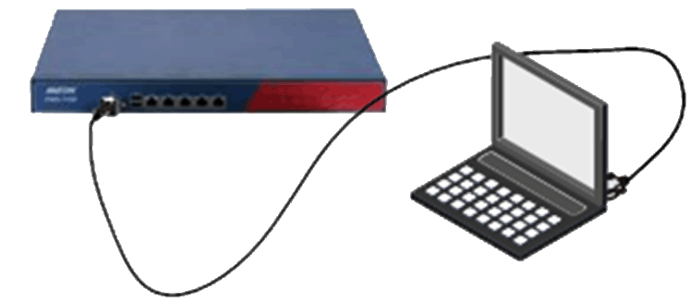
Network Appliance HW Features (2)
Console Redirection
Most AAEON FWS Series allow the BIOS to be configured from the serial port. It is additional hardware that remotely replicates the computer's VGA monitor and keyboard.

Slide 11
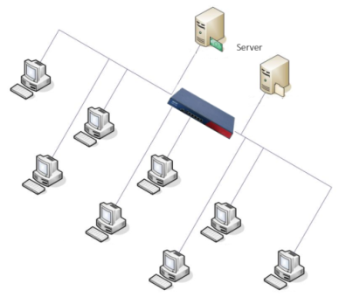
Network Appliance HW Features (3)
Remote Boot From LAN (PXE)
PXE booting is one of the many ways you can boot a computer, (embedded device or just about anything (even a toaster oven) entirely from the network without any form of storage on the destination computer (RAM aside).

Slide 12
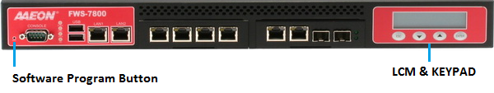
Network Appliance HW Features (4)
LCM & Key Pad Control
1. 2 x 16
2. Easy & Quick Operation
3. Customize for Customer’s AP
Software Program Button
Programmable to call software via the PC bus to mark system back to default setting

Slide 13
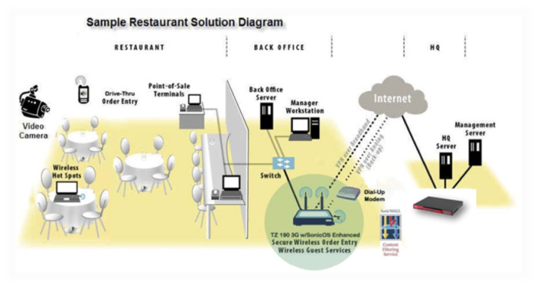
Network Appliance HW Features (5)
Unified Threat Management (UTM)
UTM is the evolution of the traditional firewall into an all-inclusive security product capable of performing multiple security functions within a single appliance.

Slide 14
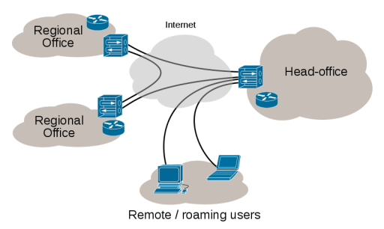
Network Applications (1)
Virtual Private Network (VPN)
VPN extends a private network and the resources contained therein, across public networks such as the Internet. VPN enables a host computer to send and receive data across shared or public networks with all the functionality, security and management policies of the private network.

Slide 15
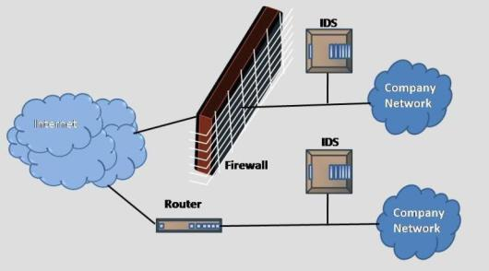
Network Applications (2)
Intrusion Detection System (IDS)
A device or software application that monitors networks and systems for malicious activities or violations and produces reports to a Management Station.
IDS over Firewall
Firewalls are like front doors. They guard well but not against back doors that might be existing in the infrastructure. Malicious hackers and script kiddies can find the smallest bugs in some system applications and silently create a back-door in the infrastructure. At that point, the firewall capability starts to suffer.
IPS over IDS
Intrusion Prevention Systems (IPS) are extensions to IDS which in addition to monitoring the network traffic, can further prevent/block intrusions in the future. IPS can trigger alarms, drop packets and sometimes even reset connections if any malicious activity is detected.

Slide 16
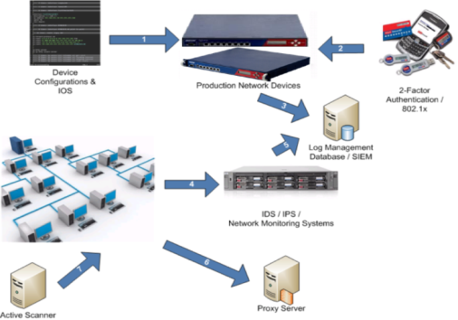
Network Applications (3)
Intrusion Prevention Systems (IPS)
Network security appliances that monitor network and system activities for malicious activity. The main functions of Intrusion Prevention Systems are to identify, log, attempt to block/stop and report malicious activities.

Slide 17
Network Applications (4)
IPS vs. IDS
Objective | IPS |  | IDS
 | In-line, Automatic Block | Priority | Out-of-band, Human Alert | Priority
Stability | Crash is catastrophic – network goes down | 1 | Crash is annoying to security analysts who lose visibility – but no impact on network or apps | 4
Performance | Processing designed for peak network load (Gbps) Small memory buffers (µsecs of latency) Above required for interior network deployment and application transparency | 2 | Processing designed for average network loads Large memory buffers to absorb traffic bursts, creating seconds to minutes of latency Above okay since out-of-band and well within human response time | 3
Accuracy –False Positives | False blocks @ Gbps rates and thousands of filters—kills applications | 3 | Burdens security analysts with chasing false alarms | 2
Accuracy –False Negatives | Preventing automatic blocking of good traffic trumps failure to detect anomalies | 4 | Missed anomalies may be missed attacks(information is power) | 1

Slide 18
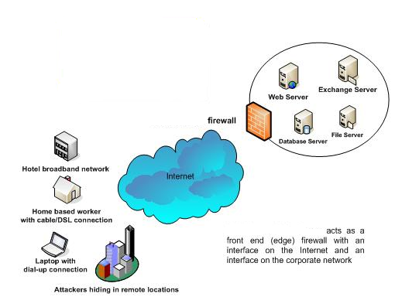


Firewall Application Diagram (1)
FWS-7200 & FWS-2200
Notes:
Main act offerings for IT Security
Increasing number of high profile hacks, virus outbreaks and identity thefts to the more minor annoyance of spam and spyware clogging up your inbox and slowing systems down

Slide 19
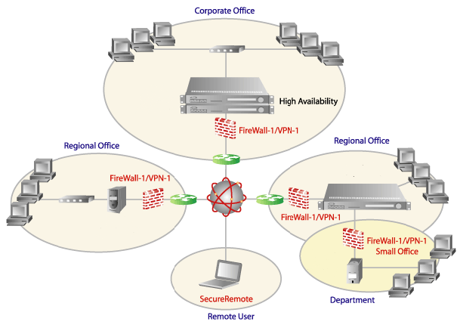


Firewall Application Diagram (2)
Notes:
VPN

Slide 20
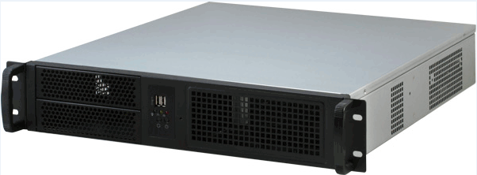


NVR Series Roadmap
Best Sell
NEW
Q2/14’’
NVR-Q67-A10-RM
NVR-Q67S-A10-RM
-Intel® i7/i5/i3 + Q67 (B)
-SATAII x 7
-8 x Hot Swappable + 1HDD
-USB2.0 x 6 (2 front, 4 rear)
-VGA x 1, DVI x 1, DP x 1
-Intel® i7/i5/i3 + Q87
-SATAII x 14, RAID 0/1/5/10
-10 Hot Swap. + OS HDD
-VGA x 1, , DP x 1, HDMI x 1
- Support USB 3.0 and PoE
19”
Rackmount
-Intel® i7/i5/i3 + Q67 (B)
-SATAII x 7
-2U Chassis, 6 + 1 HDD Bay
- USB2.0 x 4 (rear I/O)
-VGA x 1, DVI x 1, DP x 1
NVR- 6300S
NVR-B75-A10
NEW
Q3/14’’
Desktop Tower
- Intel® i7/i5/i3 + B75
- SATA x 7(w/SATA expansion
card)
- 5 x Hot swappable HDD
Bay + 1 system HDD
- VGA x 1, HDMI X 3
NVR-RISC(TBD)
Embedded Linux
4CH Full HD
Giga ethernet x 1
H.264 High Profile
decoding
- VGA x 1,HDMI x 1
NEW
Q2/14’’
-D2550+ ICH10R
-SATAII x 6
-4 x Hot swappable HDD Bay
-VGA x 1, DVI x 1
- USB2.0 x 6
NVR-2350S
NVR-CV
- Intel® Bay Trail 1.91GHz
- SATA x 6, USB2.0
- 4 x Hot swappable HDD
- PoE (optional) support
- VGA x 1,HDMI x 1
MP
Developing
Planning
Q4/13’
Q1/14’
Q2/14’
Q3/14’

Slide 21


Video Management System
Video Intelligence enables security to do the followings:
Vehicle Parking Management
Detecting and Counting People
Head and Face Detection
Behavioral Analysis Application
High Security Zone Surveillance
Abandoned Objects Detection

Slide 22






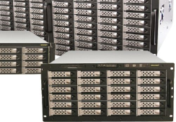

Connection Diagram
Location A
Location B
IP Cam
Video Server
SD CCTV Cam
PoE Switch
NVR-B75
NVR –Q67S
HDMI
(Option)
Note: In small deployment, LAN port A to switch, LAN port B to storage system
Storage
Monitoring

Slide 23
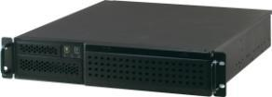
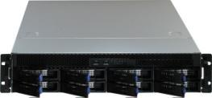
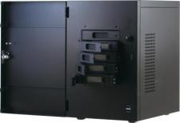
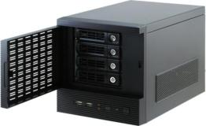
NVR Series (in MP)
NVR-Q67
NVR-Q67S
2U Rackmount
6 x internal HDD Bay
+ 1 x OS HDD
8 x Hot Swappable HDD Tray
+ 1 x OS HDD
NVR-B75
NVR-CV
Desktop Tower
5 x Hot Swappable HDD Tray
+ 1 x OS HDD
4 x Hot Swappable HDD Tray
+ 1 x OS HDD

Slide 24
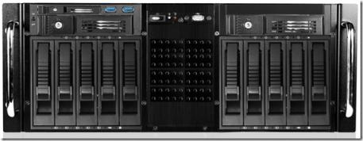
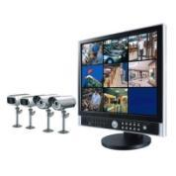


NVR-6300S
Concept Photo Only
Main Feature
4U 19” Rackmount platform
Intel® 4th Generation Core™ i7/ i5/i3 Processors
Intel® Q87 chipset
DDR3 1333/1600 Hz Non-ECC, Un-buffered Memory, up to 32 GB
14 x SATA ports to support massive storage
1xPCIe [x16], 1xPCIe [x4] expansion support
2 x Gigabit LAN Controller, 7 x USB ports
3 x Audio Jack ( Mic-in / Line-in / Line-out )
RAID 0/1/5/10 support
USB 3.0 x 2
Power Button
Slim DVD/RW
USB 2.0 x 1
Target Market
Multimedia
High End Surveillance
2.5” Hot Swappable HDD
3.5” Hot Swappable HDD Tray x 12
Launching Q2 2014

Slide 25
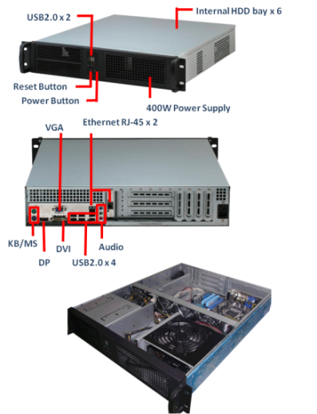
NVR-Q67 Rackmount Networking Video Recorder System
Main Feature
2U 19” Rackmount platform
Intel® Socket 1155 The 2nd Generation Core™ i7/ i5/i3 Processors
Intel® Q67 chipset
DDR3 1333/1066 Hz Non-ECC, Un-buffered Memory, up to 32 GB
Integrated Graphics Processor
4 x SATA 3Gb/s port(s), blue; 3 x SATA 6Gb/s port(s), white
1 x PCIe 2.0 [x4], 2 x PCI expansion support
2 x Gigabit LAN Controller, 4 x USB2.0
Target Market
Multimedia
Surveillance

Slide 26
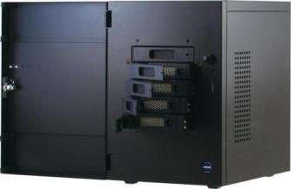
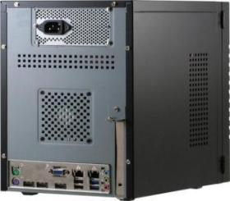

NVR-B75 Retail Appliance NVR System
Swappable HDD bay x 5
Highlights
Small-size to Mid-size Scale: Retail industry, POS banking, household surveillance…
5 x Hot Swappable HDD Tray standalone system
Supports up to 25TB of storage capacity
Display Support: 1 x VGA, 3 x HDMI
USB3.0 x 2
400W Power Supply
VGA
Ethernet RJ-45 x 2
HDMI x 3
KB & Mouse
Audio
USB x 4

Slide 27
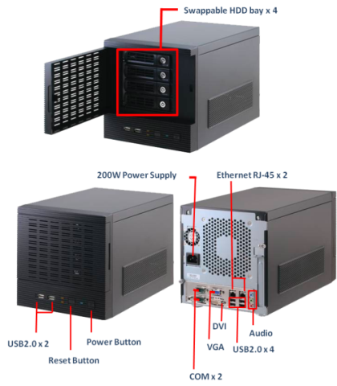


NVR-CV Standalone NVR System
Main Feature
4 Hot Swappable HDD Bay standard Mini Tower system
Intel® Atom™ D2550 Processor
Intel® ICH10R
Supports DDR3 1066 SO-DIMM x 2, max. 4GB
6 x SATA ports
6 x USB2.0
Audio Jack : Line in, Mic in, Line out
Display support: VGA , DVI
2 x COM ports
Target Market
Multimedia
Surveillance

Slide 28
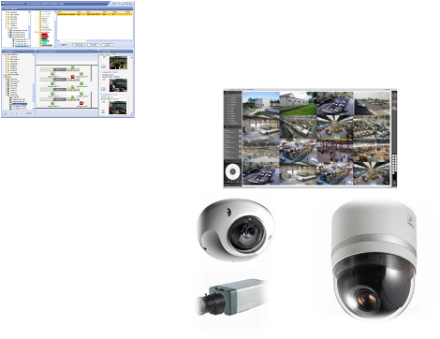

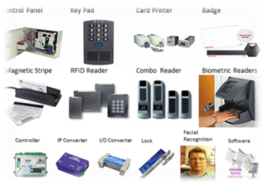
  Access Control Diagram
Integration Server
Event
Video
Access Control System
Video Management System

Slide 29
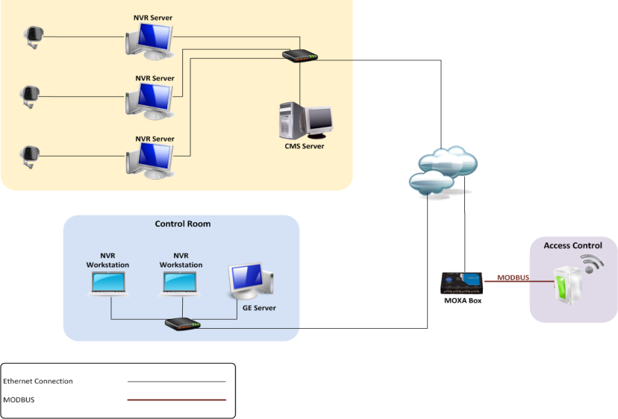







Retail Application Diagram
NVR Server
NVR Server
CMS Server
NVR Server

Slide 30

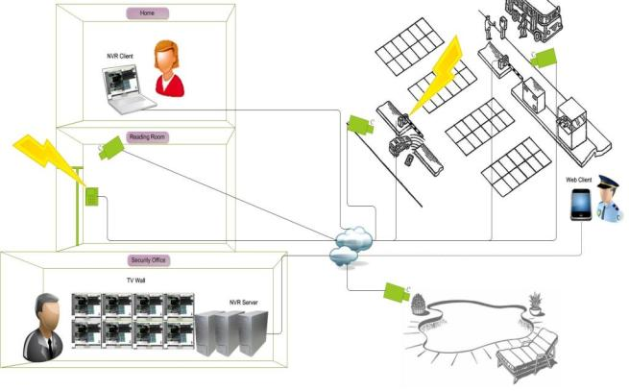



  Attendance Management System
Access Control
In
Door #1
Out
NVR Client
IP Camera
Card Reader
Access Control
IP Camera
In
Door #2
Out
IP Camera
Card Reader
NVR
In
Door #3
Out
IP Camera
Card Reader
Command Center

Slide 31
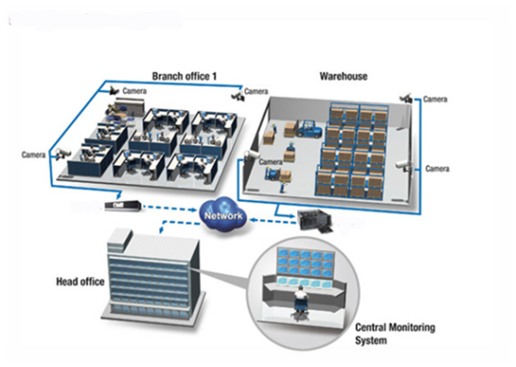
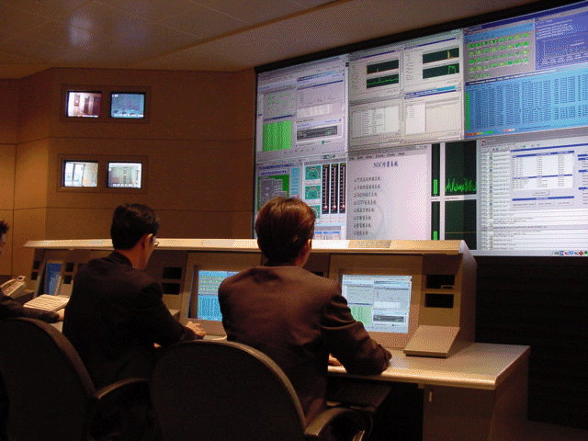





  Diagram for Video Security
Enterprise Management
(分公司)
(倉儲監控)
IP CAM
NVR
Anywhere
CCD+ VIDEO SERVER
IE
3G
IP CAM
NVR
Internet
or VPN
Control Center
NAS
CCD+ VIDEO SERVER
IE
IP CAM
NVR
CMS Server
IP CAM
Remote management
Computer Facilities

Slide 32
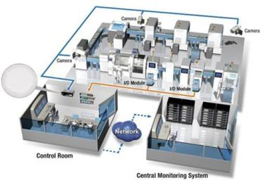


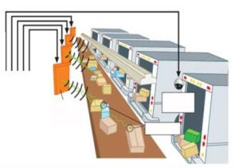




Factory Monitoring Surveillance Diagram
CCD + Video server
Factory I
…
Hub
NVR 1
…
Internet
Router
NVR 2
IP Camera
I/O
Router
CMS Server
VMS(CMS+NVR)
Camera
RFID Reader
NVR
EPC Tags
ISP
Factory II

Slide 33





Competitor Analysis
Company | Advantech | Advantech | Advantech | Advantech | Nexcom | Nexcom | Nexcom | AAEON | AAEON
Model | NVS-3520 (Video Server) | PVS-2200 (Fanless DVR) | PVS-640 (4U NDVR) | PVS-5120 (16 channel DVR) | NViS 2140H | NViS 7281 | NViS 8480 | NVR-CV | NVR-Q67
Photo
CPU/Chipset | ATOM(D525) + NVIDA ION2 | ATOM D510 +NM10 | Intel 945G + ICH7 | Intel 945G + ICH7 | ATOM D525 +ICH8 | Intel Core i3 / i5 / i7+ Q57 | Intel Core i3 / i5 / i7+ Q67 | Cedarview D2500+ICH10R | Intel Core i3/ i5 / i7+ Q67
Compression Format | H.264/MPEG4/ MJPEG | H.264 | H.264 | H.264
Display/ Video | VGA HDMI | VGA | VGA | VGA | VGA 4-channel Full-D1 Display/ Recording | VGA | VGA+DVI | VGA+DVI | DB-15 x 1 DVI-D x 1 HDMI x 1 LVDS x 1
LAN | 1 x Giga LAN | 1 x Giga LAN | 2 x Giga LAN | 1 x Giga LAN | 2 x Giga LAN | 2 x Giga LAN | 2 x Giga LAN | 2 x Giga LAN | 2 x Giga LAN
Expansion | NA | NA |  |  | MiniPCIe x 1 | 1 x PCI 1 x PCIe x 4 | 1 x PCIe X8 1 x PCIe X4 1 x PCIe X1 1 x PCIe X1 | 1 x PCIe X 16  | 1 x PCIe X4 2 x PCI slot 1 x TPM (option)
Storage | 2.5”HDD | 2.5”HDD x1 | 3.5”HDD x3 | 3.5” HDD x 2 | 2.5”HDD x1 | 3.5”HDD x2 CFast x 1 | 3.5”HDD x6 | 3.5” HDD x 4 | 3.5” HDD x 6 + 2.5” x 2
Operating Temperature | -10~60°C | 0~40°C | 0~50°C | 0~40°C | 0~45°C | 0~40°C | 0~45°C | 0~40°C | 0~40°C
Power Input | DC 19V | DC 12V | 100~240VAC | 100~240VAC | DC 9V~36V | AC 100V to 240V input | AC 100V to 240V input | DC 12V | 100~240VAC
COM/USB | 0 / 4 | 2 / 4 | 6 / 4 | 2 / 4 | 2 / 6 | 1 / 4(USB 3.0) | 2 / 4 | 5/6 | 6 / 8

Slide 34


For questions or more information, please contact:
sales@aaeon.com.tw
www.aaeon.com

